Slide 1
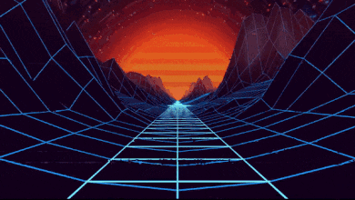
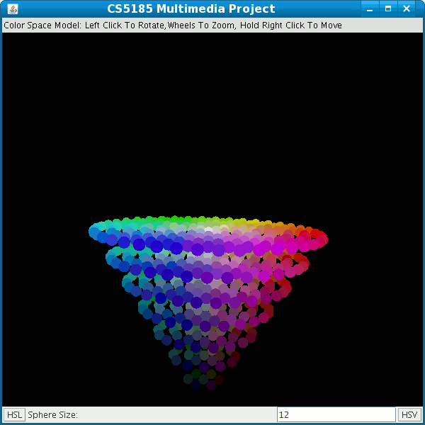

Realm of Pixels and Color Models
6252-ITAI-1378-Comp Vision-Artificial Intel-RT-15698 - Spring 2025
Professor Anna Devarakonda
Team EyeConic
Brooke Broderick - W217065417
Matthew Choo - W206744145
Cameroun White-W216530571
Melvis Maduagwu-W216890463
Erick Banegas - W216200956
Nancy Chieu-W000098778
Yoana Cook - W215913890

Slide 2
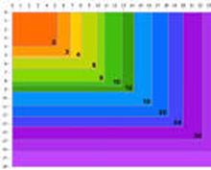
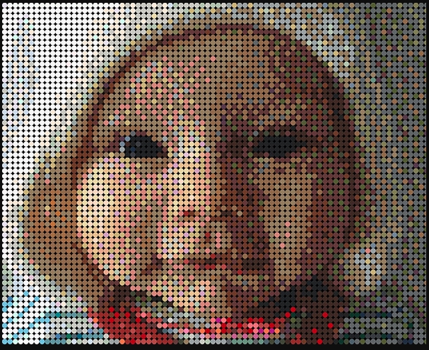

What is a Pixel?
A pixel is one of the small dots or squares that make up an image on a computer screen. The greater the number of pixels per inch the greater the resolution, the more real or accurate the image looks.
Any digital image is made up of pixels, and when someone talks about the resolution of a computer monitor or TV screen, they're referring to the number of pixels. Older televisions have around 300,000 pixels, but new high-definition TVs can have more than two million pixels, which produces a very sharp, clear image. The word pixel came from pictures, or pics, and element, and was coined in 1969. (Gills)

Slide 3
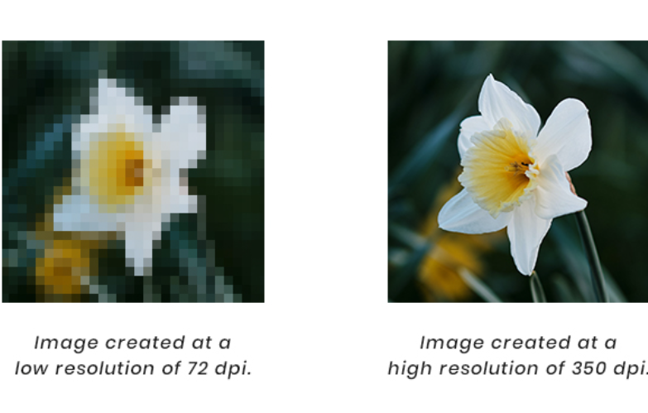
How Pixels Form Images?
Pixels form images by acting as tiny squares that each represent a specific color value, and when arranged together in a grid, they create a complete picture; the more pixels an image has, the higher its resolution and the more detailed the image appears, as each pixel contributes to the overall visual composition. (PGBS)

Slide 4
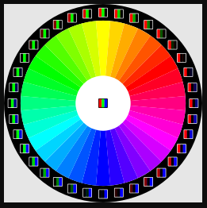
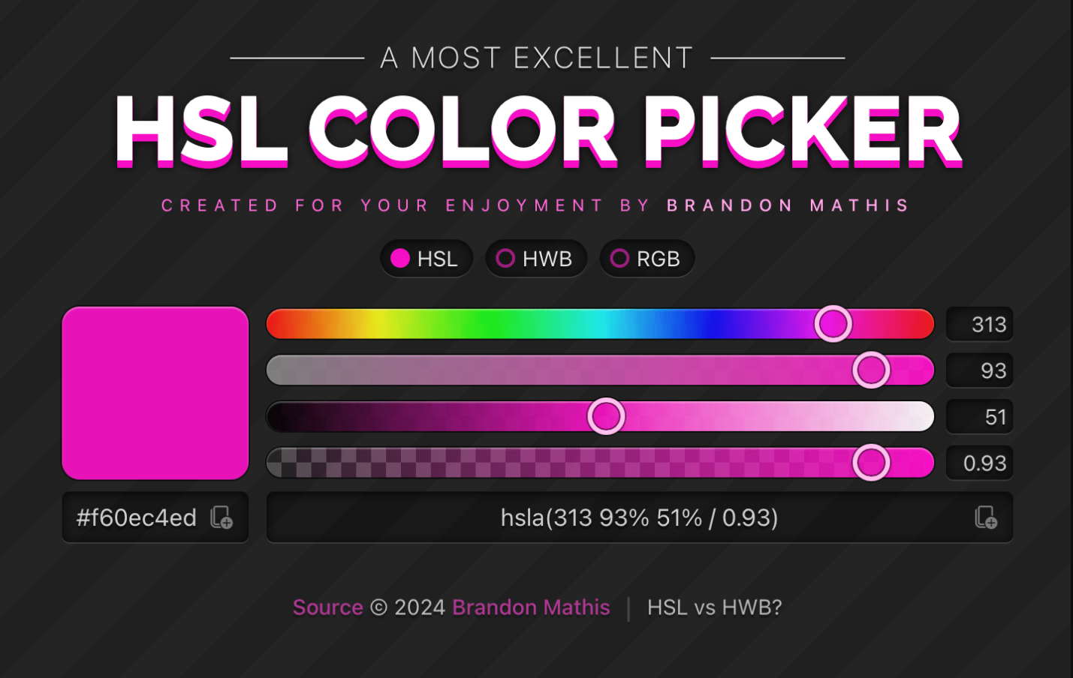
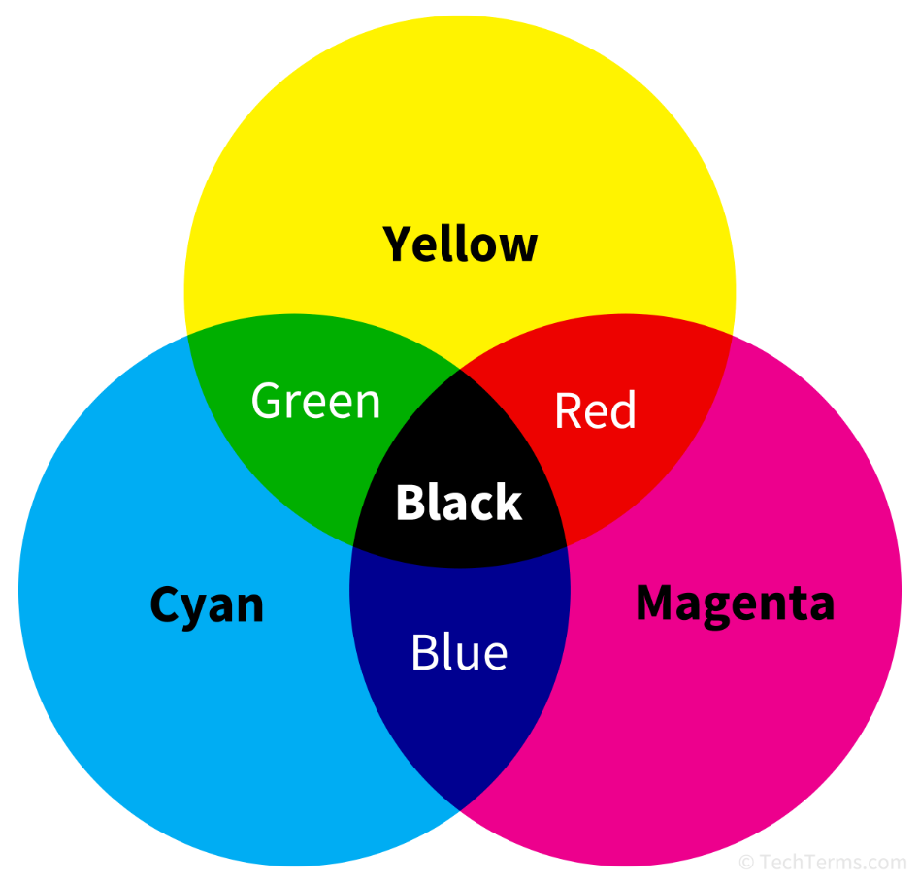
Color Models (RGB, HSV, etc.)
Color models are mathematical representations of colors used in digital graphics, photography and printing. Examples of this color models are as follows:
RGB (Red, Green, Blue)- RGB combines different intensities of Red, Green, and Blue to create other colors. The intensity of each component ranges from 0 to 255 and it’s an additive model, so combining the highest intensity of all components produces “white”. For example:
(255,0,0)- Pure Red
(0,255,0)- Pure Green
(0,0,255)-Pure Blue
(255,255,255)-White
(0,0,0)- Black
HSL (Hue, Saturation, Lightness)- HSL is quite similar to RGB. Hue represents the type of color, It’s value ranging from 0° to 360° with 0° for pure red, 120° for pure green 240° for pure blue , Saturation represents the intensity of the color measured in percentage. Lightness represents the color brightness or “whiteness”, also measured in percentage. For example:
(0°, 100%, 100%)- Pure Red
(240°, 50%, 100%)- light blue
CMYK (Cyan, Magenta, Yellow, Black)-The CMYK color model describes colors based on their percentage of Cyan, Magenta, Yellow and Black. Many computer printers and traditional "four-color" printing presses use the CMYK model. In the CMYK model, by mixing cyan, magenta, yellow and black inks or paints, you can create nearly any color desired. For example:
(0%, 100%, 100%, 0%) - Pure Red (No Cyan, full Magenta & Yellow)
(0%, 0%, 0%, 100%) - Black

Slide 5
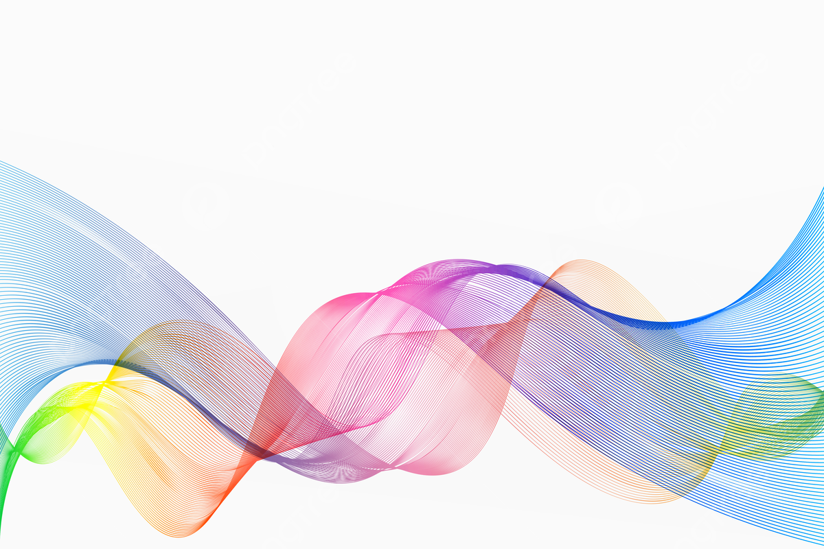
Seeing the World Through Color Models
Color plays a huge role in how we perceive the world, and in the digital space, it is all about color models. These models are essential frameworks that help computers interpret, manipulate, and display colors accurately. Whether it is editing a photo, enhancing a video, or training an AI to recognize objects, color models are at the heart of it all.
What Exactly Are Color Models?
Think of color models as a way to describe colors using numbers. Instead of saying "this is a shade of blue," a computer breaks it down into specific values, like mixing paint but in a structured, mathematical way. This ensures consistency across screens, cameras, and software.
Why Do They Matter?
Color models are a big deal in computer vision. They help AI recognize objects, improve image quality, and even detect patterns in medical scans or security footage. Without them, digital images wouldn’t look as sharp, and AI would not "see" the world as clearly.
Where Do We Use Them?
Pretty much everywhere! Whether it is Photoshop adjusting image tones, movie CGI making visuals pop, or AI recognizing faces and objects, color models play a behind-the-scenes role. They even help make video calls look better by adjusting lighting and color balance in real time.
Color models might not be something we think about daily, but they’re quietly shaping the way we experience digital visuals, bringing everything to life, from stunning movie effects to smart AI applications.

Slide 6
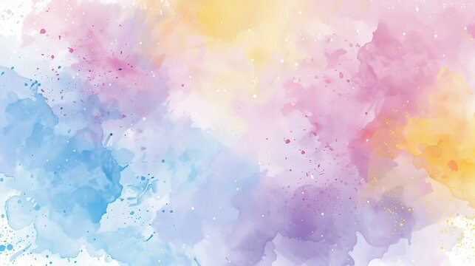
The RGB Color Model: The Backbone of Digital Color
The RGB color model is at the heart of how we see and work with color on screens. Whether it is your phone, computer, or TV, every image you see is built using a mix of Red, Green, and Blue light. This model is crucial in computer vision, digital imaging, and anything involving vibrant visuals.
Breaking Down RGB
RGB is made up of three primary colors: Red, Green, and Blue. Each color has an intensity value ranging from 0 to 255, meaning you can create over 16 million different shades! That is why digital images can be so rich and detailed, tiny variations in these three colors give us everything from deep blues to warm pastels.
How RGB Colors Mix
The magic of RGB comes from how colors blend. Need Yellow? Just mix Red and Green at full intensity. Want White? Combine all three colors at their maximum values. The way RGB adds colors together makes it different from traditional paint mixing, more light means brighter colors, which is why screens glow rather than absorb light like printed images.
Where Do We Use RGB?
RGB is everywhere in digital imaging. Digital cameras capture color using it, monitors display images through it, and software like Photoshop relies on it for editing. Because our eyes naturally perceive color in a way that aligns with RGB, it is the perfect model for realistic and immersive visuals across all screens.

Slide 7

The HSV Color Model: A More Intuitive Way to Work with Color
While RGB is great for digital screens, it is not always the easiest way to think about color. That is where the HSV color model comes in. Instead of mixing Red, Green, and Blue light, HSV breaks color down into three parts: Hue (the actual color), Saturation (how vibrant it is), and Value (how bright it appears). This makes it a more natural way for humans to select and adjust colors.
How HSV Works
HSV breaks color into three simple parts: Hue - The type of color (like red, blue, or green) measured in degrees on a color wheel. Saturation - How bold or faded the color appears. High saturation means vibrant colors, while low saturation looks dull or grayish. Value - The brightness of the color, from completely dark (black) to fully bright. Since HSV separates brightness from color, it makes adjustments easier, making it a go-to for color correction and design.
Why HSV is Better for Certain Tasks
One of HSV’s biggest advantages over RGB is that it feels more natural. Need to adjust the brightness of an image without affecting its color? No problem. Want to tweak the vibrancy without shifting the overall shade? Easy. Since HSV keeps color and intensity separate, it is ideal for image editing, color-based filtering, and segmentation, especially in tasks like object detection or AI-driven image analysis.
Where We See HSV in Action
HSV is a favorite in computer vision and image processing. It is used in facial recognition, object tracking, and color-based segmentation, where specific colors need to be isolated or enhanced. Graphic design software like Photoshop also uses HSV to let designers fine-tune colors in a way that makes sense visually, rather than working with raw RGB values.

Slide 8
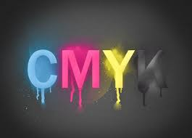
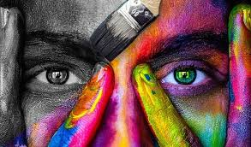
CMY and CMYK: The Printing Color Models
While RGB and HSV are great for digital screens, CMY and CMYK shine in the world of printing. These models work differently because they rely on subtractive color mixing, meaning they absorb light rather than emit it.
CMY vs. CMYK - CMY (Cyan, Magenta, Yellow) is the base model, while CMYK adds black (K) for deeper contrast and sharper prints.
How It Differs - Unlike RGB and HSV, which mix light to create colors, CMY and CMYK mix ink, making them ideal for accurate color reproduction on paper.
Why It Matters - In printing, colors must be precise to match digital designs. That’s why magazines, posters, and packaging rely on CMYK to ensure colors look just right.
Each color model has its place: RGB for screens, HSV for intuitive color adjustments, and CMYK for high-quality prints.

Slide 9
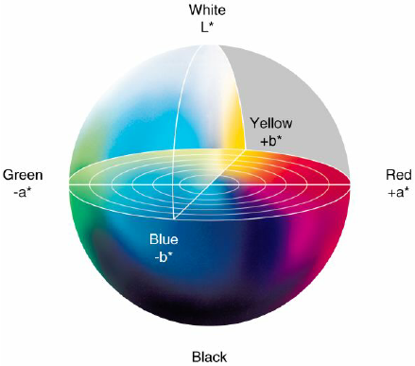
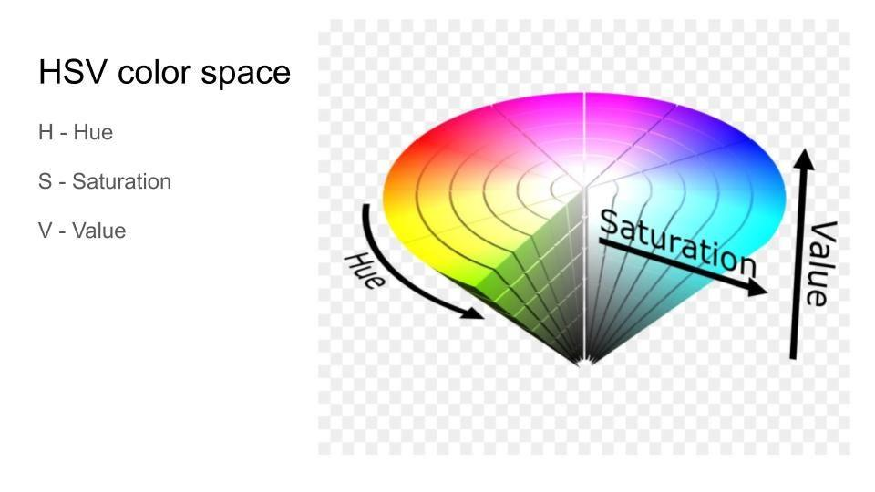
Wrapping It All Up
Color models are the secret sauce behind everything we see on screens and in print. Whether it is RGB lighting up our devices, HSV making color adjustments easier, or CMYK ensuring crisp, accurate prints, each model has its own role to play.
Understanding how these models work it is not just tech jargon, it is what makes everything from video games and movies to magazines and advertisements look as good as they do. The next time you tweak an image, pick a paint color in a design app, or admire a stunning poster, you will know exactly what is happening behind the scenes.
Color is not just about what we see, it is about how we create, manipulate, and bring ideas to life!

Slide 10
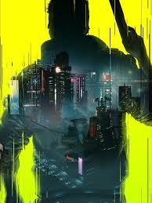

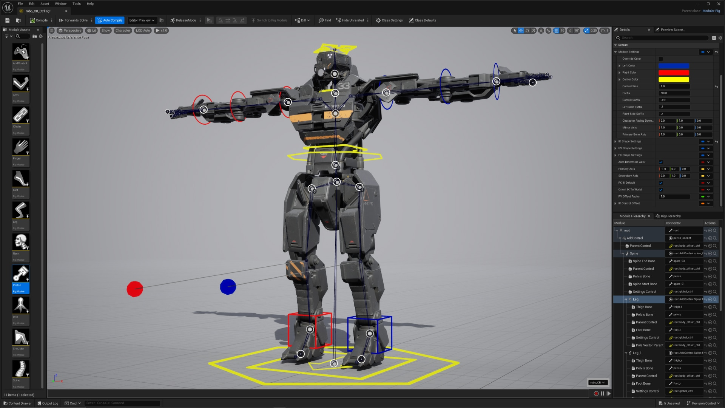
Examples of Using Pixels and Color Models
RGB (Red, Green, Blue) – Used in screens and graphics
Every pixel is a combination of Red, Green, and Blue values (0-255).
Example: In video games like Cyberpunk 2077, RGB controls how neon lights glow on characters and objects.
In movies, RGB is used in CGI rendering, such as in Avatar, where entire alien environments are digitally created.
CMYK (Cyan, Magenta, Yellow, Black) – Used in printing
Not used for digital screens but essential for printed materials like posters and advertisements.
Example: A gaming magazine or a printed movie poster is created in CMYK.
HSV (Hue, Saturation, Value) – Used in color adjustments
Used in Photoshop, 3D modeling, and shader programming.
Example: In Unreal Engine and Unity, HSV is often used in post-processing effects to dynamically adjust lighting moods in games.

Slide 11
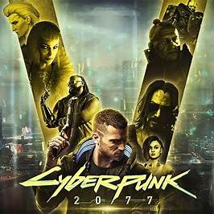
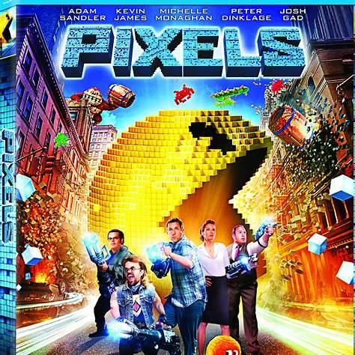
YUV – Used in video compression
Essential for streaming services and film production.
Example: YouTube and Netflix use YUV color space to compress movies without losing quality.
LAB – Used in color correction
LAB allows for precise color manipulation.
Example: Pixar uses LAB color space to ensure accurate lighting in animated movies.

Slide 12
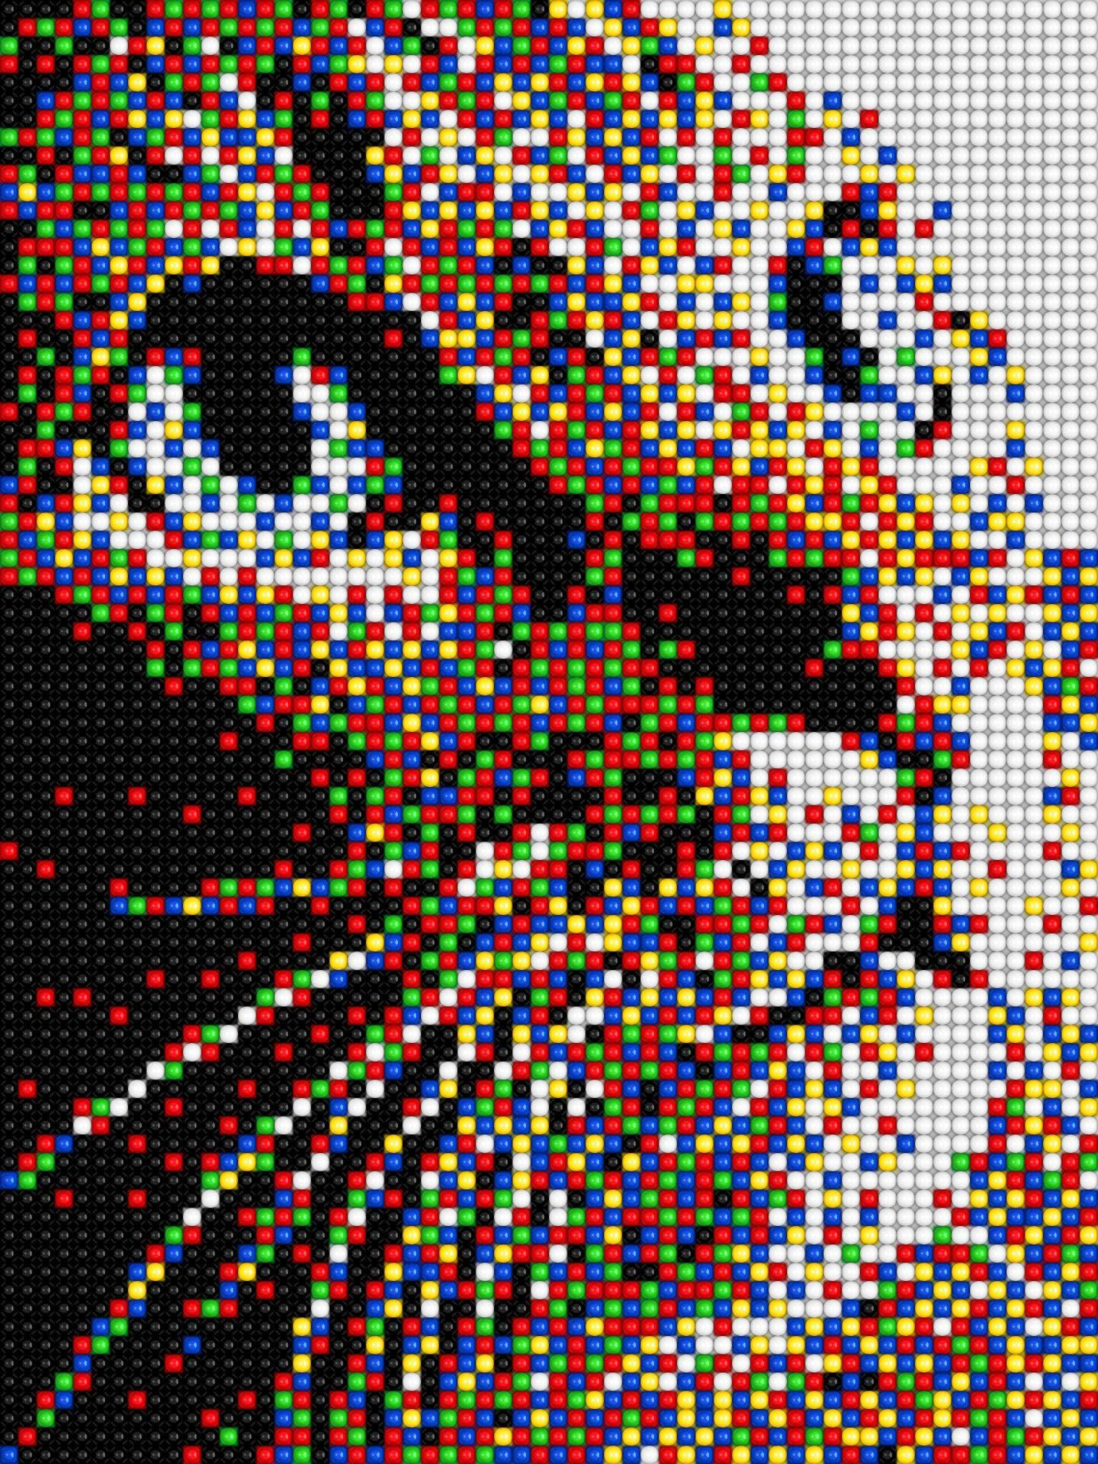
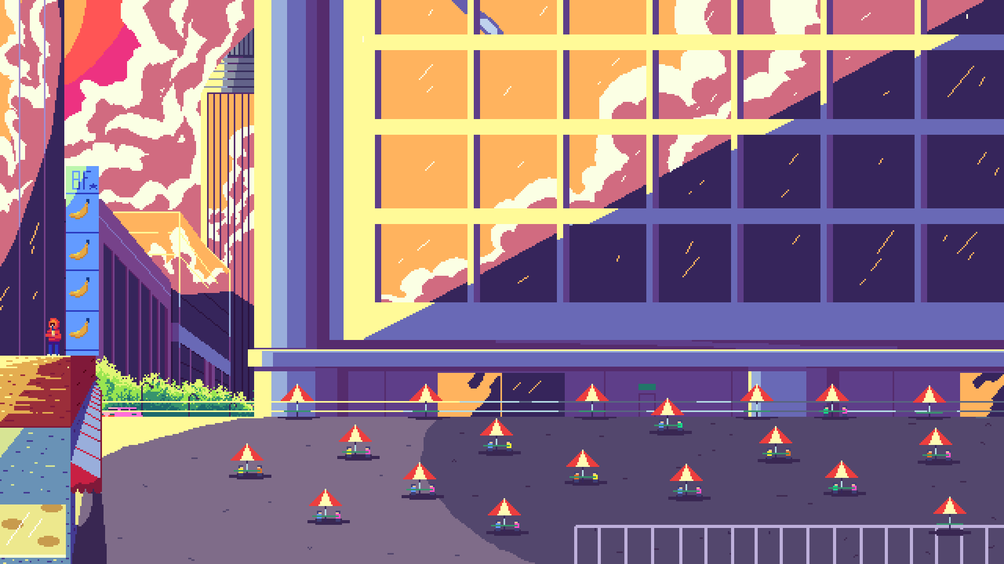

Applications of Pixels and Color Models
1. Video Games
Game engines like Unreal Engine and Unity render pixels using RGB and shaders.
Ray tracing (used in Minecraft RTX and Cyberpunk 2077) simulates realistic light reflections using RGB values.
2. Movies and CGI
VFX studios use RGB and YUV for rendering 3D animations (e.g., Marvel’s Avengers movies).
Color grading software like DaVinci Resolve uses LAB and HSV to adjust scene mood.
3. Virtual Reality (VR)
VR headsets like Oculus and HTC Vive rely on RGB pixels to create immersive worlds.
Games like Half-Life: Alyx use RGB pixels with shading techniques to enhance realism.

Slide 13


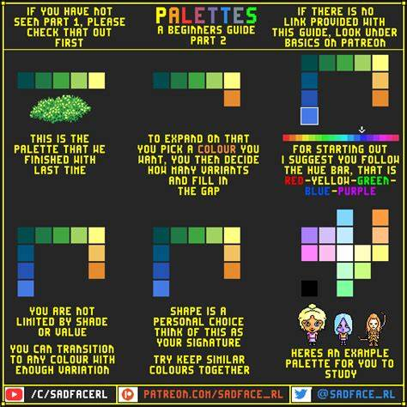
4. Computer Vision and AI
Self-driving cars use RGB cameras to detect objects.
Face recognition algorithms process HSV and LAB color spaces for better accuracy.
5. Simulations and Virtualization
Architectural visualization (e.g., rendering a 3D building in Blender) relies on RGB.
Flight simulators (e.g., Microsoft Flight Simulator) use pixel shading and color models to mimic real-world environments.

Slide 14
Applications: Pixel, RGB, and HSV work together
Pixel: each pixel represents a single color, and the number of pixels determines its image resolution. To edit a
digital image, individual pixels can be manipulated.
RGB: Different value of RGB can determine the digital displays (TV, computer, or cell phone screens),
web design, and digital photography.
HSV: HSV stands for Hue, Saturation, and Value. Its design aligna how human vision perceives color-making
attributes. Graphic design tools can choose a color by adjusting its HSV. Color segmentation can be done
from an image by manipulating its HSV.values. HSV also allows the computer vision application to identify
the color ranges easily.
(Generative AI)
Notes:
RGS

Slide 15
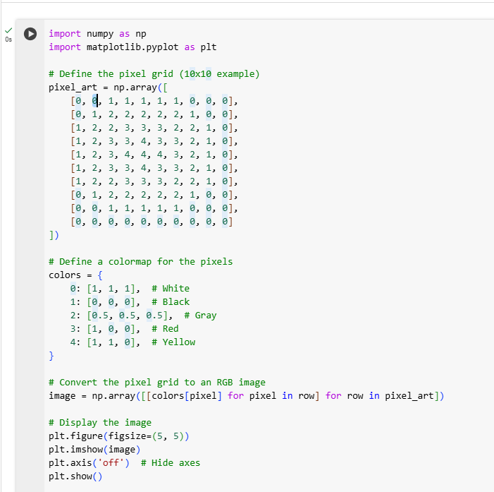
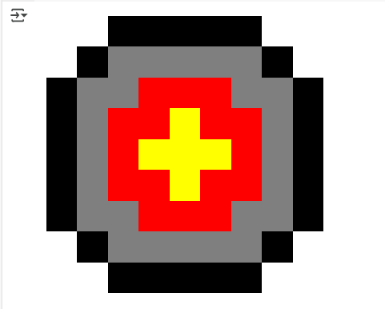
Coding for Pixel
This code shows how to create a pixel. It shows of how it is coordinated by defining the pixel grid, and a colormap for the pixels. Then converting it to the pixel grid as and RGB image and displaying the image.

Slide 16
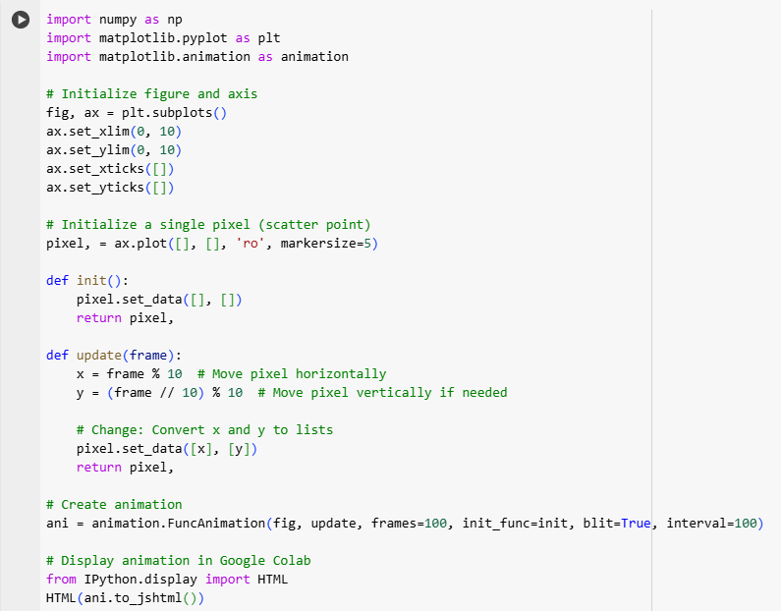
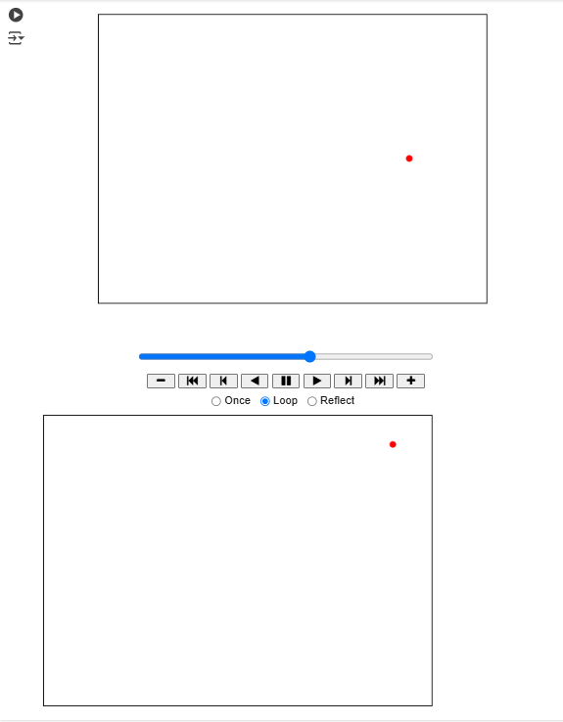
Pixel Movement
This program shows how a pixel moves from one frame to another.

Slide 17
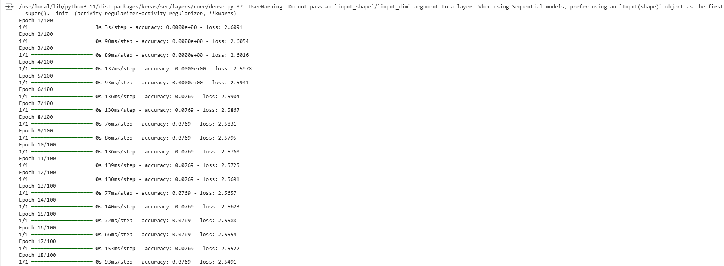
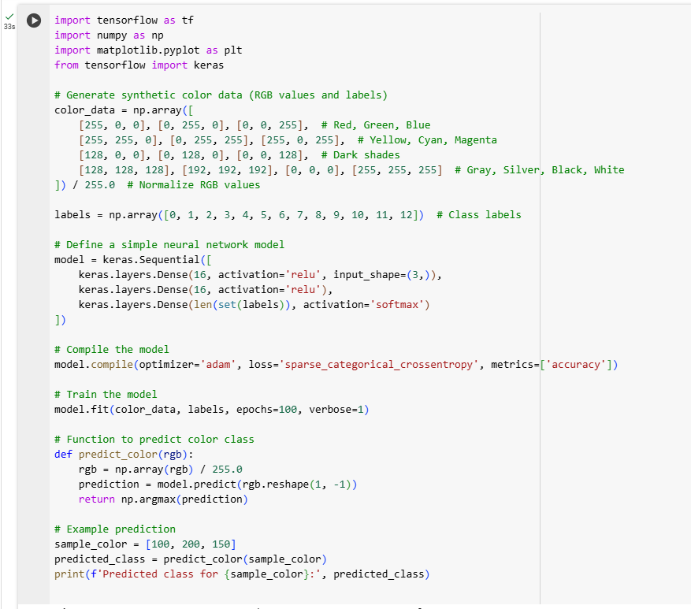
Color Models RGB
This code shows the color models of RGB. It represents the color data and models.

Slide 18
Pixel Movement
This program shows how a pixel moves from one frame to another.

Slide 19
Applications: Pixel, RGB, and HSV work together
Pixel: each pixel represents a single color, and the number of pixels determines its image resolution. To edit a
digital image, individual pixels can be manipulated.
RGB: Different value of RGB can determine the digital displays (TV, computer, or cell phone screens),
web design, and digital photography.
HSV: HSV stands for Hue, Saturation, and Value. Its design aligna how human vision perceives color-making
attributes. Graphic design tools can choose a color by adjusting its HSV. Color segmentation can be done
from an image by manipulating its HSV.values. HSV also allows the computer vision application to identify
the color ranges easily.
(Generative AI)
Notes:
RGS

Slide 20
Applications: Pixel, RGB, and HSV work together
Pixel: each pixel represents a single color, and the number of pixels determines its image resolution. To edit a
digital image, individual pixels can be manipulated.
RGB: Different value of RGB can determine the digital displays (TV, computer, or cell phone screens),
web design, and digital photography.
HSV: HSV stands for Hue, Saturation, and Value. Its design aligna how human vision perceives color-making
attributes. Graphic design tools can choose a color by adjusting its HSV. Color segmentation can be done
from an image by manipulating its HSV.values. HSV also allows the computer vision application to identify
the color ranges easily.
(Generative AI)
Notes:
RGS

Slide 21
A Brief Reflection 1
Nancy Chieu: I learned the basics of Pixel and Color Models. We chose challenge 1 to explain the basic concepts and applications with some images. This is the very basic for learning about computer vision.
Matthew Choo: We chose challenge 1 because we want to understand the purpose of pixels and color modeling. Was able to understand about the RGB, HSL & CMYK and coding to create a pixel. Lastly, have also learned how it is being used to create art, media and games.
Melvis Maduagwu: We chose this challenge one because colors are a crucial component of images. I learned that each pixel has just one color made through different a combination of red, green, and blue lights. A composition of thousands to millions of these pixels make up the display on a computer screen.
Cameroun White: We chose challenge 1 to further dive into pixels and color models and in doing so I know that the more pixels the clearer a digital image will be for example.
I learned about the use of each color models.

Slide 22
A Brief Reflection 2
Pixels and color models are the foundation of digital visuals, playing a crucial role in video games, movies, and virtual simulations. Understanding how colors are represented and manipulated helps create more immersive and visually striking experiences.
In gaming, color models like RGB and HSV enhance realism, while movies use YUV and LAB for compression and post-production. For example, Cyberpunk 2077 showcases detailed lighting effects using RGB, and movies like Pixels (2015) integrate pixel-based graphics to bring classic video games to life.
This subject highlights how technology transforms visual storytelling, pushing the boundaries of digital art, realism, and interactive experiences. The evolution of pixel technology continues to shape entertainment, making it a vital field for innovation.
(Erick Banegas)

Slide 23
A Brief Reflection 3
Yoana: I never really gave much thought to pixels until I realized just how much they shape everything we see on a screen. These tiny building blocks come together to create every digital image, and the more pixels an image has, the sharper and more detailed it appears. It is fascinating to think that older televisions had around 300,000 pixels, while modern high-definition screens boast millions—no wonder today’s visuals look so crisp and lifelike!
What really stands out to me is how pixels rely on different color models to produce images. RGB (Red, Green, Blue) is the standard for digital screens, combining different intensities of these three colors to create virtually any shade. It is the reason why characters in films like Avatar appear so realistic.
Beyond entertainment, pixels play a critical role in fields like AI and computer vision. Self-driving cars, use RGB cameras to detect objects, while HSV (Hue, Saturation, Value) is widely used in graphic design and color correction. Even streaming services like Netflix and YouTube rely on YUV color space to compress videos efficiently while maintaining high quality.
It’s incredible how something as small as a pixel is the foundation of so many industries, whether it is gaming, filmmaking, artificial intelligence, or even virtual reality. Understanding how pixels and color models work has given me a whole new appreciation for the technology that powers our digital world.

Slide 24
Final Reflection
This presentation explores how pixels and color models are part of our everyday lives. From the screens on our smartphones and tablets to the TVs and computer monitors we use, these concepts are everywhere. They also play a huge role in things like digital photography, web design, printed materials, digital art, and even the content we share on social media.
In our deep dive learning about pixels and color models, we discovered that in the early days of color TV, engineers realized that by combining just three primary colors—red, green, and blue—they could reproduce a full spectrum of colors.The combination tricked our eyes into seeing all the colors of the rainbow. Without this discovery, RGB would have ended up with a system that doesn’t match our natural perception of color, leading to odd or unnatural-looking displays. Editing and designing images would be complicated. Without RGB, these interfaces would look completely different, making it harder to read, navigate, or even enjoy content.If those engineers had not figured out how to use pixels to build images, we might not have the sharp, detailed screens we are used to today. We cannot fathom dealing with blurry or low-resolution displays, making it harder to see everything clearly or enjoy high-quality visuals.
In short, pixels and color models are behind almost everything we see and interact with in the digital world.
(Brooke Broderick)

Slide 25
Bibliography
Adobe. Color Models and Color Management in Digital Imaging
Generative AI: It’s supported by info from across the web and Google’s Knowledge Graph.
Gillis, Alexander S. “What Is a Pixel? Definition, Meaning and How They Work:
TechTarget.” WhatIs, TechTarget, 30 Aug. 2022,
www.techtarget.com/whatis/definition/pixel.
Gonzalez, R. C., & Woods, R. E. (2018). Digital Image Processing (4th ed.). Pearson.
“Home.” PGBS, 20 Dec. 2023, www.proglobalbusinesssolutions.com/.
Pantone. Pantone,
www.pantone.com/articles/color-fundamentals/color-models-explained?srsltid=AfmBOopRI
0D7DFylitMuKTsZU7_qmZ6u2x3LBjWDymErDEd-FFPdtQEg. Accessed 10 Feb. 2025.
Sharma, G. (Ed.). (2003). Digital Color Imaging Handbook. CRC Press.

Slide 26
GitHub Links
https://github.com/MattChoo0/Pixel
https://github.com/MattChoo0/Color-Models-RGB
https://github.com/MattChoo0/Pixel-Movement

